Slide 1
Big Mountain Resort
Price Analysis
Prepared by Hannah Pierro

Slide 2
Problem Statement
Big Mountain Resort has based its ticket price on the market average plus a premium, is that the optimal price? Can we build a model that compares multiple features to justify increasing the ticket price?
Using that model, can we predict how improving or reducing features of the resort will affect the optimal ticket price?

Slide 3
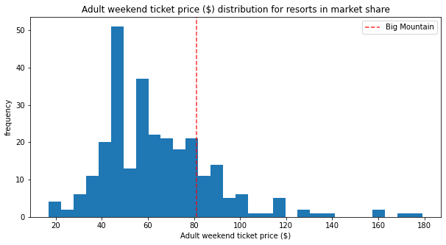
Optimal Ticket Price $95.87
Montana Resort Average Price: $51.90
Nationwide Resort Average Price: $63.81
Big Mountain Resort’s Current Price: $81.00
Projected Big Mountain Resort Price: $95.87
Our analysis supports increasing the ticket price to about $96. With 350,000 visitors buying an expected five tickets each, that’s roughly $26 million per year in additional revenue.

Slide 4
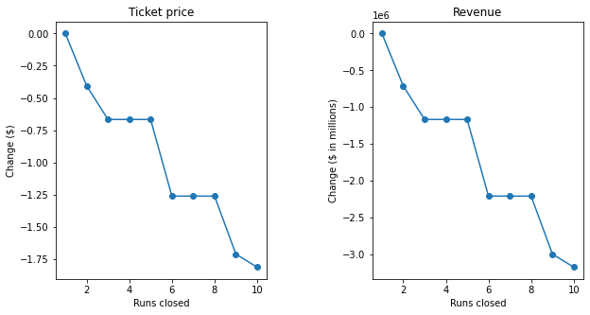
Closing Runs (1-10)
Closing runs caused the model to reduce optimal ticket price
Removing one run made no change to the model
There were two plateaus at three and at six runs
Number of Runs Closed | Drop in Ticket Price | Drop in Annual Revenue (in millions)
One Run | $0.0 | $0.0
Two Runs | -$0.41 | -$0.71
Three, Four or Five Runs | -$0.67 | -$1.17
Six, Seven, or Eight Runs | -$1.26 | -$2.20
Nine Runs | -$1.71 | -$2.99
Ten Runs | -$1.81 | -$3.17

Slide 5
Exploring Other Changes
Adding a Run, Increasing Vertical Drop, Adding a Chair: We increased the numbers of runs by one, the vertical drop by 150 ft, and the total chairs by one, it would increase the ticket price by $1.99 and annual revenue by $3.48 million.
Run, Vertical Drop, Chair, AND Snow Making Acres: We reran the same increases as above except adding two acres to snow making. There was no change to the price, the snow making area appears to be too small to affect the model.
Longest Run: We added 0.2 miles to the longest run and four acres to the snow making area and found no change.

Slide 6
Summary
Increase ticket price to $96
If the operating cost supports it, close one, five, or eight of the less used runs
Depending on operating cost, add a run, increase the vertical drop, and a chair
No benefit was found to increasing the longest run or adding man made snow acres
Recommendations

